Slide 1

Credit Card Fraud Detection Using ML Techniques
Sasanka Mouli VSS(119003233) Guide: Prof. B.Shanthi
E Phani Kaushik (119003047)

Slide 2

Problem:
To detect frauds and genuine transactions in the dataset using different models.

Slide 3
Introduction:
The number of people transacting online is increased due to digitalisation in the recent past.
This provides opportunity for the hackers to invade and loot people’s money
In Order to curb this menace , FDS(Fraud detection systems) play a major role .

Slide 4
Dataset:
The datasets contains transactions made by credit cards in September 2013 by european cardholders. This dataset presents transactions that occurred in two days, where we have 492 frauds out of 284,807 transactions. The dataset is highly unbalanced, the positive class (frauds) account for 0.172% of all transactions.
The dataset has been collected and analysed during a research collaboration of Worldline and the Machine Learning Group (http://mlg.ulb.ac.be) of ULB (Université Libre de Bruxelles) on big data mining and fraud detection.

Slide 5
It contains only numeric input variables which are the result of a PCA transformation. Unfortunately, due to confidentiality issues, we cannot provide the original features and more background information about the data. Features V1, V2, ... V28 are the principal components obtained with PCA, the only features which have not been transformed with PCA are 'Time' and 'Amount'. Feature 'Time' contains the seconds elapsed between each transaction and the first transaction in the dataset. The feature 'Amount' is the transaction Amount, this feature can be used for example-dependant cost-sensitive learning. Feature 'Class' is the response variable and it takes value 1 in case of fraud and 0 otherwise.

Slide 6
Workflow
In order to detect the fraud and genuine transactions we used the following methods
K Means(Knowledge Purpose)
Logistics Regression
Logistic Regression with SMOTE oversampling (To be completed..).

Slide 7
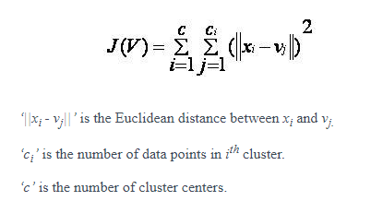
K Means Model:
k-means is one of the simplest unsupervised learning algorithms
The procedure follows a simple and easy way to classify a given data set through a certain number of clusters (assume k clusters) fixed apriori.

Slide 8

K Means Algorithm:
Let X = {x₁,x₂,x₃,……..,x_{n}} be the set of data points and V = {v₁,v₂,…….,v_{c}} be the set of centers.
Randomly select ‘c’ cluster centers.
Calculate the distance between each data point and cluster centers.
Assign the data point to the cluster center whose distance from the cluster center is minimum of all the cluster centers..
Recalculate the new cluster center using:
Recalculate the distance between each data point and new obtained cluster centers.
If no data point was reassigned then stop, otherwise repeat from step 3).

Slide 9

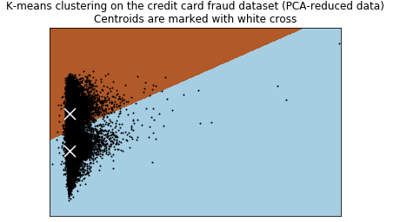
K Means Results:

Slide 10
Drawbacks :
If there are two highly overlapping data then k-means will not be able to resolve that there are two clusters.
Randomly choosing of the cluster center cannot lead us to the fruitful result.
Algorithm fails for non-linear data set.
And it gives us relatively low Accuracy.

Slide 11
Logistic Regression Model:
Logistic regression algorithm uses a linear equation with independent predictors to predict a value. We need the output of the algorithm to be class variable, i.e 0-no, 1-yes. Therefore, we are squashing the output of the linear equation into a range of [0,1] for which we use Sigmoid Function.
Linear regression and logistic regression are similar. But, the biggest difference lies in what they are used for. Linear regression algorithms are used to predict/forecast values but logistic regression is used for classification tasks.

Slide 12
Logistic Regression Algorithm:
First Step: With the sigmoid function or logit function, map the continuous predictors to a function (the logit) of the response variable, which is also continuous.The predictors can form a linear function such as
Logit(Transaction) = b + b1*x1 + b2*x2 + b3*x3 + b4*x4……
this can take on any value: from -Infinity to +Infinity
Second Step: Convert the logit into odds. This is easy because logit is nothing but the logarithm of odds of the response variable.
log (odds(Transaction)) = Logit(Transaction) where odds=logit()/(1-logit())
this can only be positive valued: from 0 to +Infinity
Third Step: Once we know the odds, we know the probability score. Probability, p
p = odds/(1+odds)
this can only be valued from 0 to 1

Slide 13
Fourth Step: Calculate the Likelihood function using
Product{(Pr^Yi){(1-Pr)^(1-Yi)}
Fifth Step: Apply log on the above Likelihood function.
Sum[{Yi*Log(Pr)} + {(1-Yi)*Log(1-Pr)}]

Slide 14
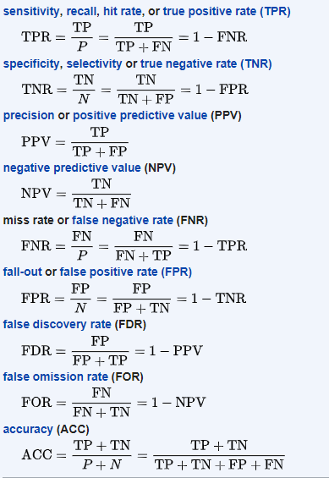
Formulae:

Slide 15
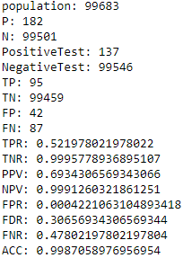
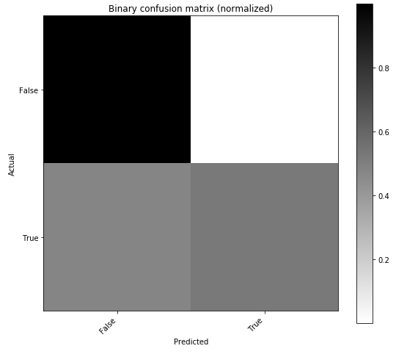
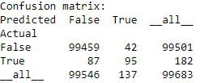
Logistic Regression Results for Test Size of 0.35

Slide 16
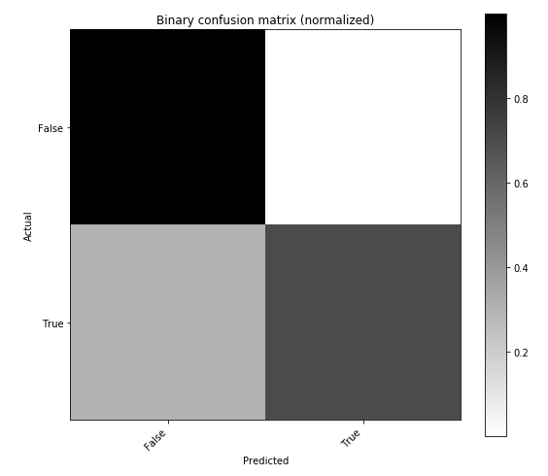
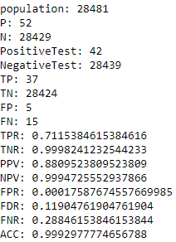
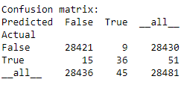
Logistic Regression Results for Test Size of 0.10

Slide 17
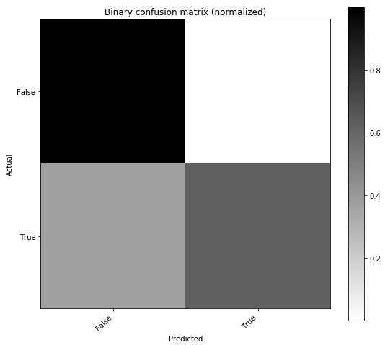
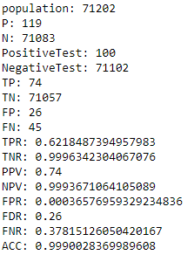
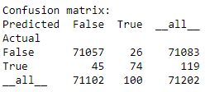
Logistic Regression Results for Test Size of 0.25

Slide 18
Logistic Regression with SMOTE Oversampling
SMOTE(Synthetic Minority Oversampling Technique)
Creates new “Synthetic” Observations.
This algorithm is used to address the Class imbalance of the dataset.
The main principle of this is to create minority points near the neighbourhood of the feature points this, effectively forces the decision region of the minority class to become more general.

Slide 19
SMOTE Algorithm
Identify the feature vector and its nearest neighbourhood
Take the difference of the two.
Multiply the difference with a random number between 0 and 1
Identify the new point on the line segment by adding the random number to feature vector.
Repeat this process for identified feature vectors.

Slide 20
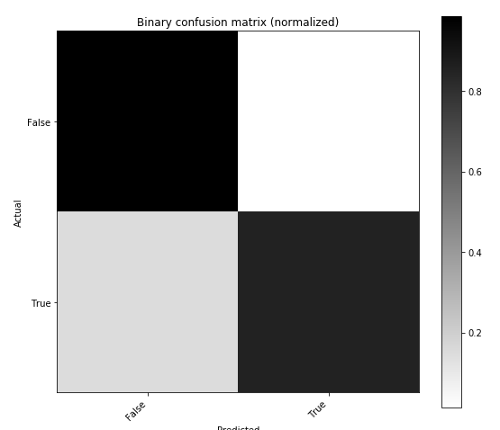
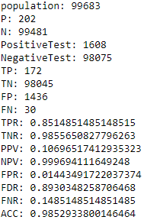
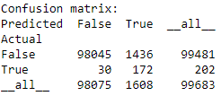
Logistic Regression with SMOTE Results
For test size of 0.35

Slide 21
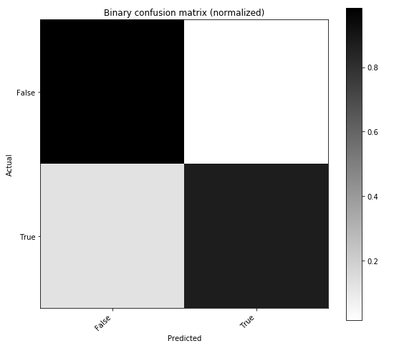
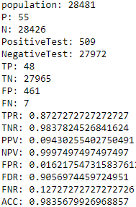
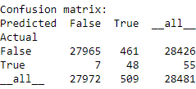
For test size of 0.10

Slide 22
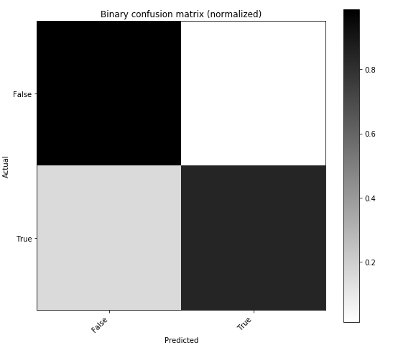
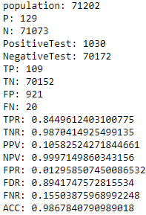
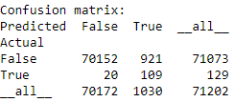
For test size of 0.25

Slide 23
Comparison of Results
Alogirithm Metric | Logistic Regression | Logistic Regression with SMOTE
TPR | 0.5219 | 0.851
Accuracy | 0.9987 | 0.98529
For test size of 0.35
Alogirithm Metric | Logistic Regression | Logistic Regression with SMOTE
TPR | 0.7115 | 0.85148
Accuracy | 0.99929 | 0.98356
For test size of 0.10

Slide 24
Alogirithm Metric | Logistic Regression | Logistic Regression with SMOTE
TPR | 0.6218 | 0.84496
Accuracy | 0.99900 | 0.9867
For test size of 0.25

Slide 25
Conclusion
Based on the Comparisons the Logistic Regression with SMOTE Oversampling gives with higher True Positive Rate at the cost of Precision value.
So Balancing the dataset would be the optimal proceeding.

